Slide 1
Aerial Pathfinding Reconnaissance Status Update
Jason Gilman, Max Griffith, Mark Johnson, Dilanka Weerasinghe

Slide 2
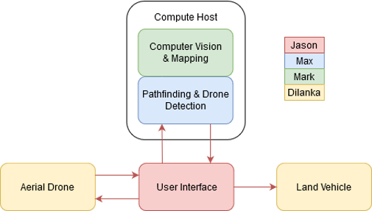
Overview
Goal: Use aerial drone footage to find a safe path for a land vehicle.
Team Members and Responsibilities:
Dilanka Weerasinghe (Data Collection & Drone Control)
Automated drone control and collection of aerial footage
Mark Johnson (Computer Vision & Mapping)
Production of an obstacle map from drone videos
Max Griffith (Pathfinding & Drone Detection)
Determination of vehicle starting location and route
Jason Gilman (Device Networking & UI)
Creation of user interface and network interconnect
System Block Diagram

Slide 3
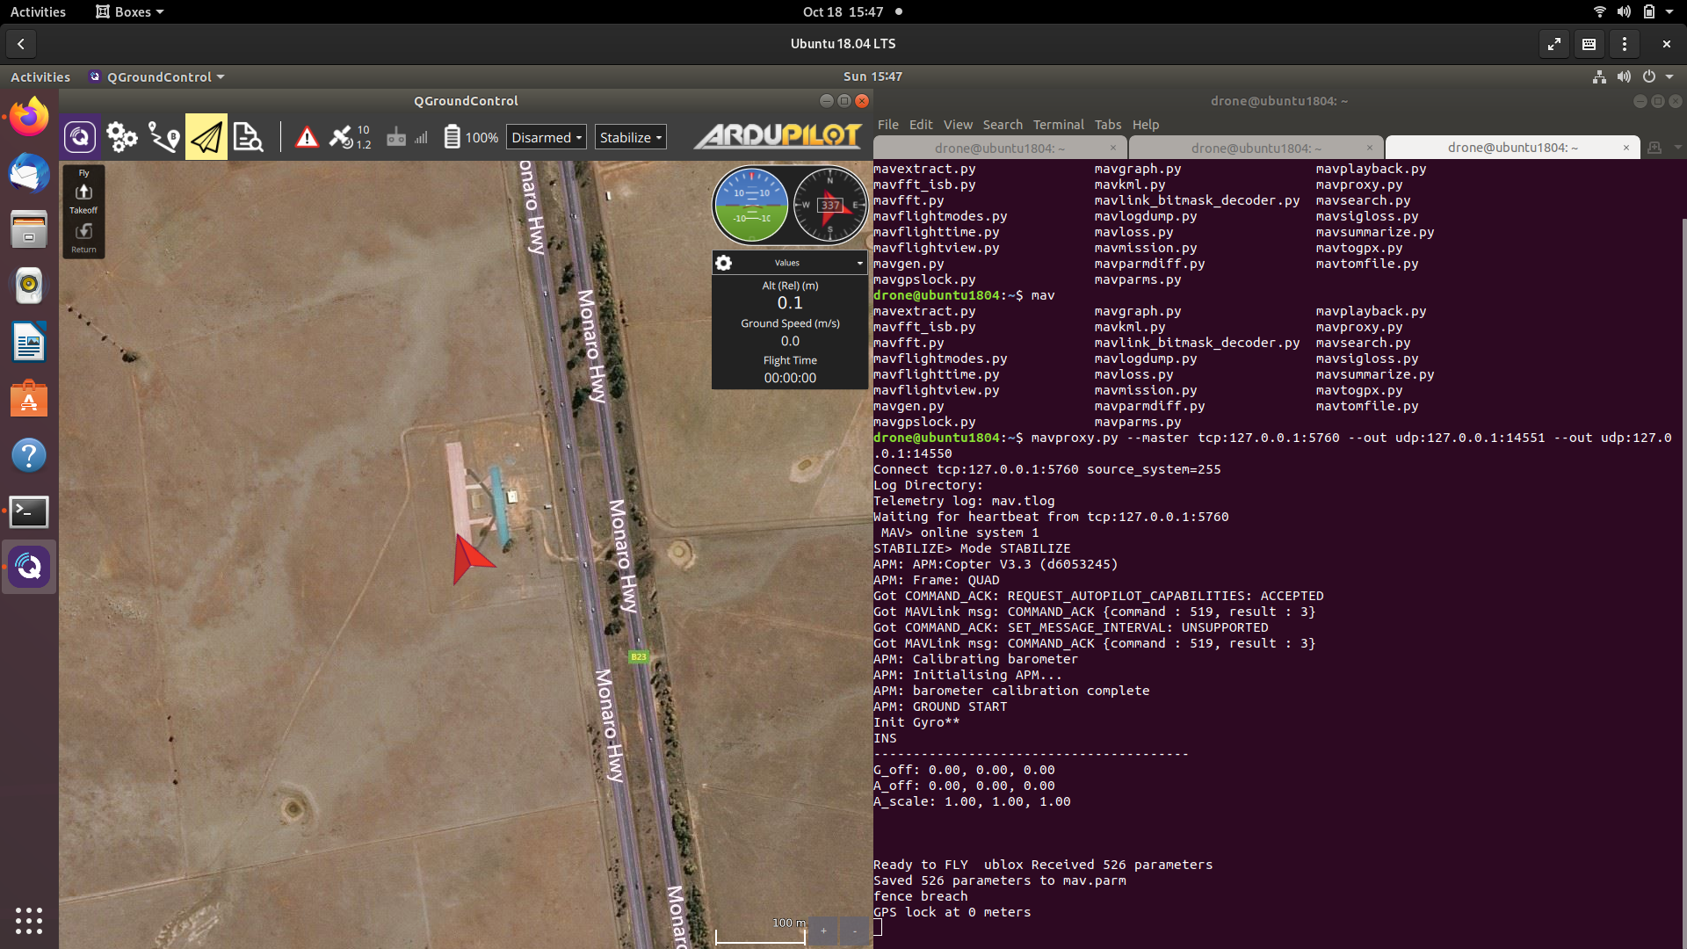
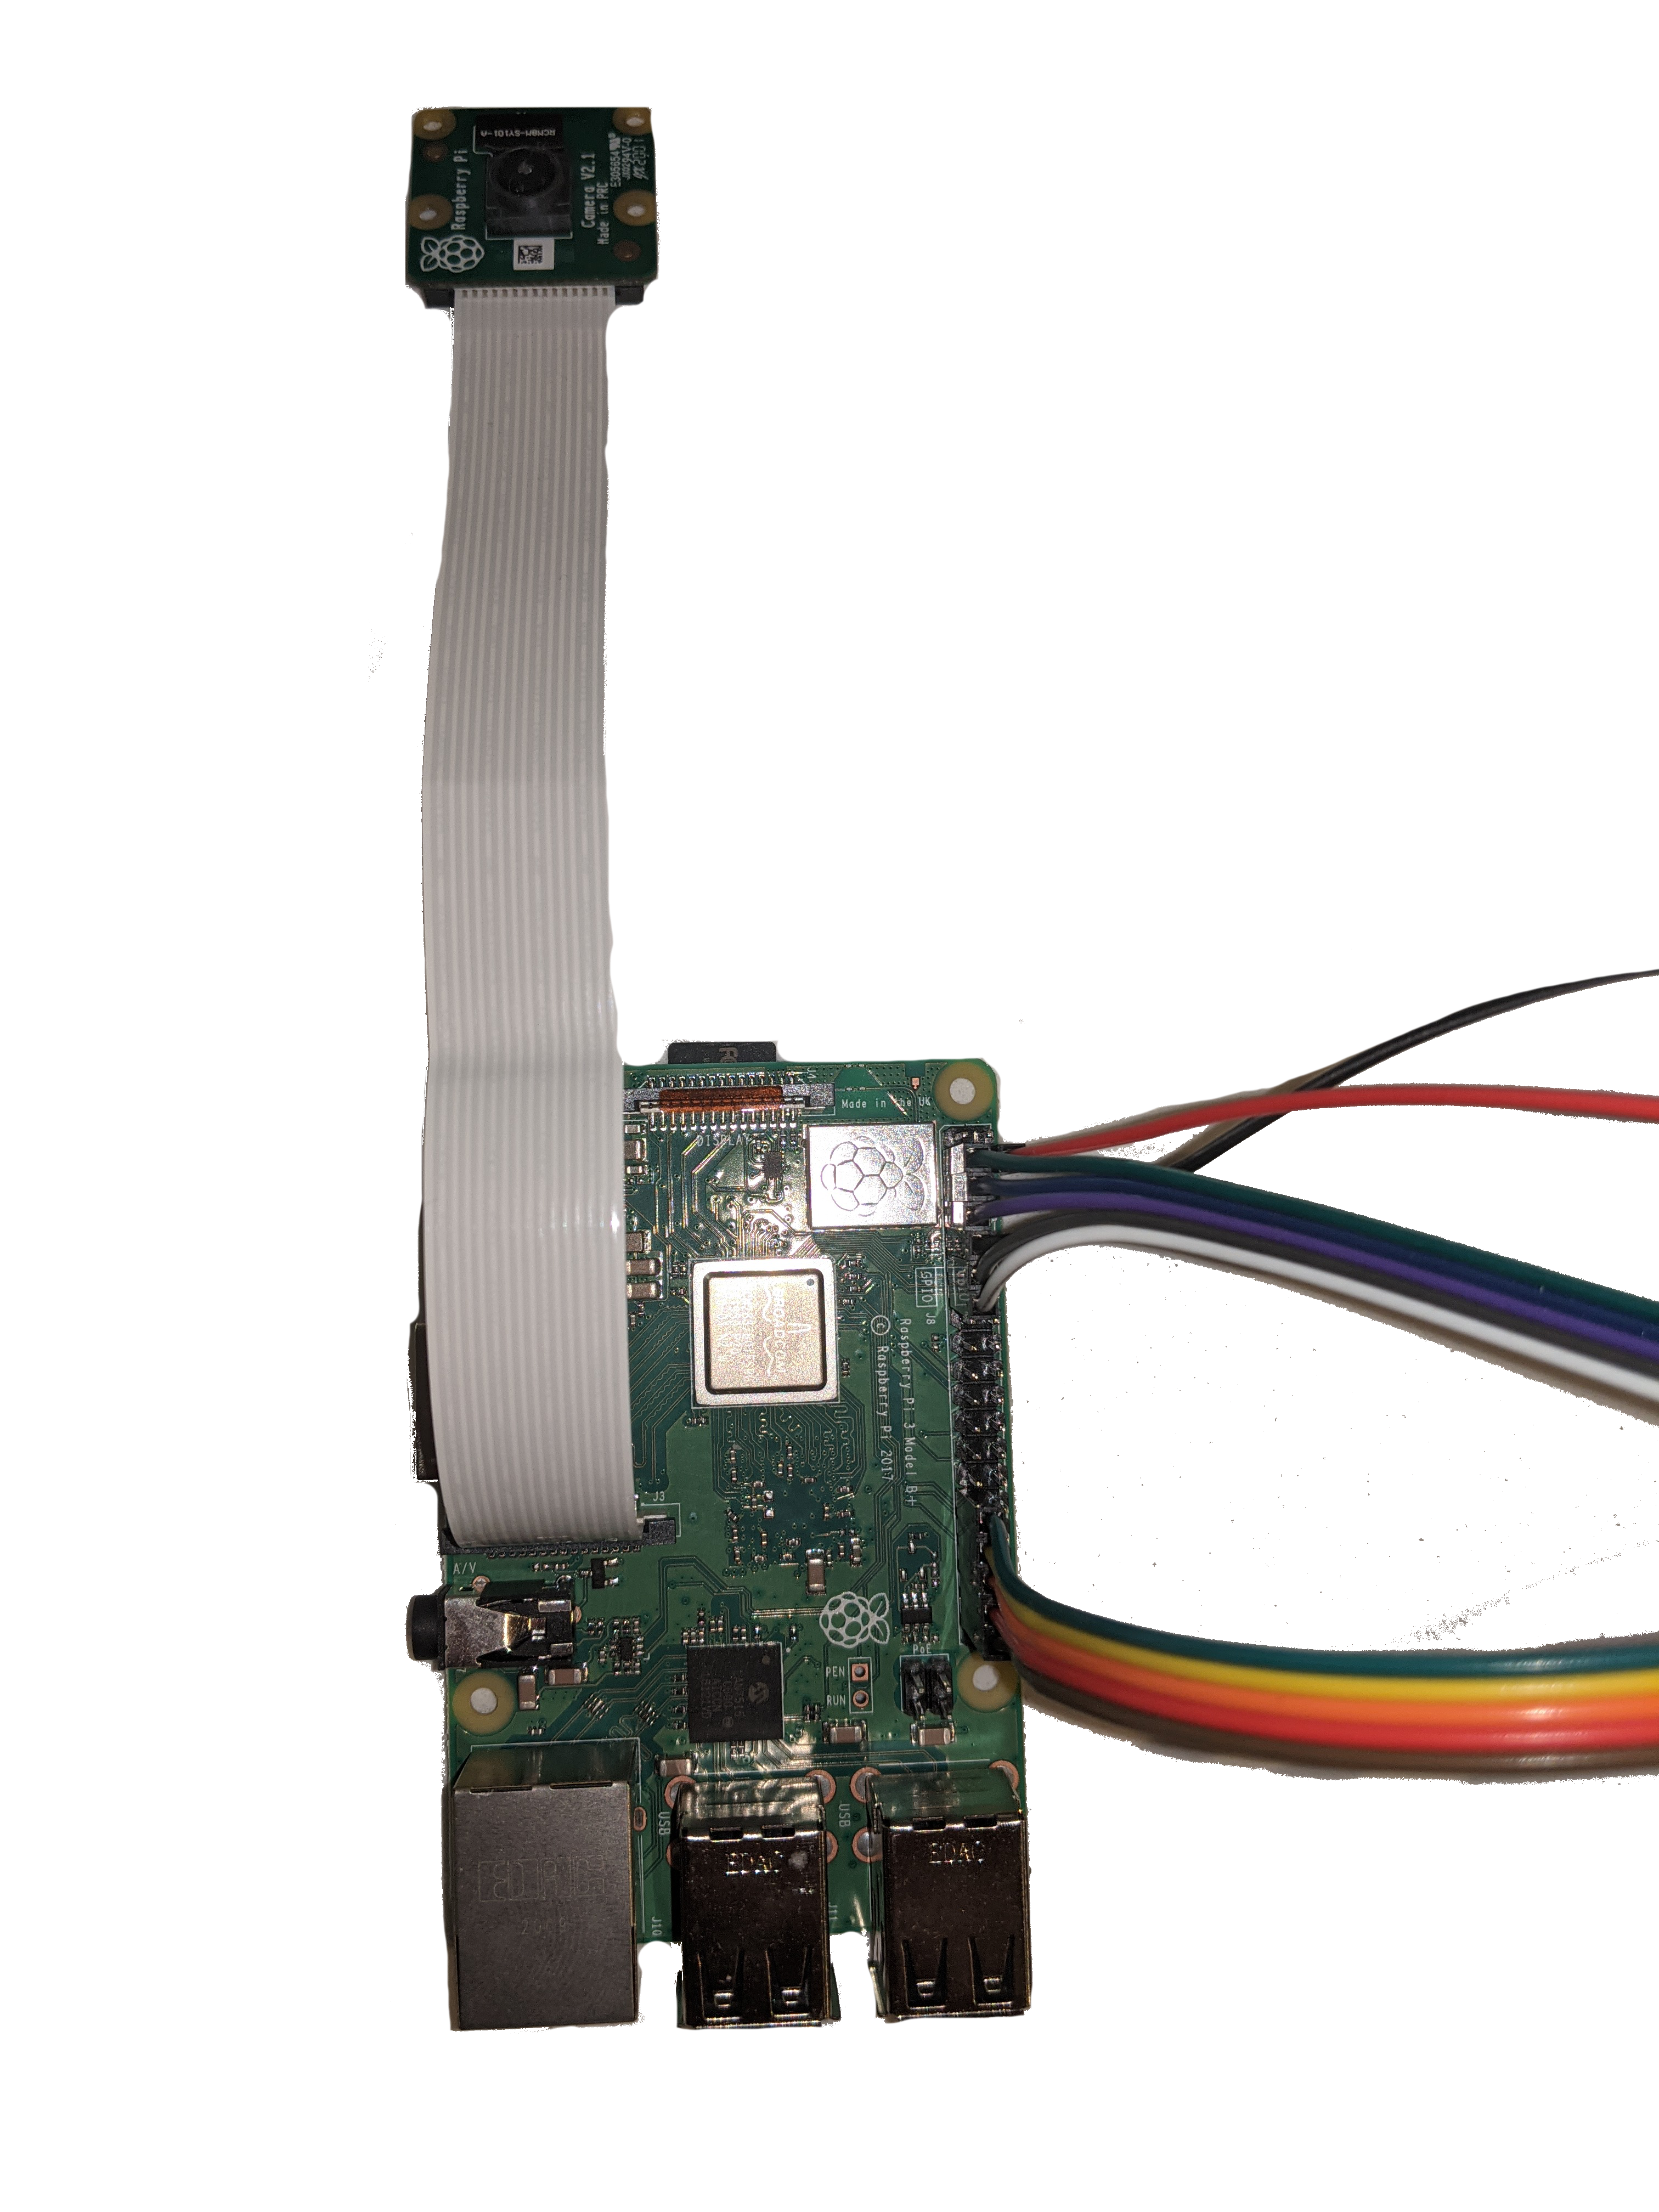
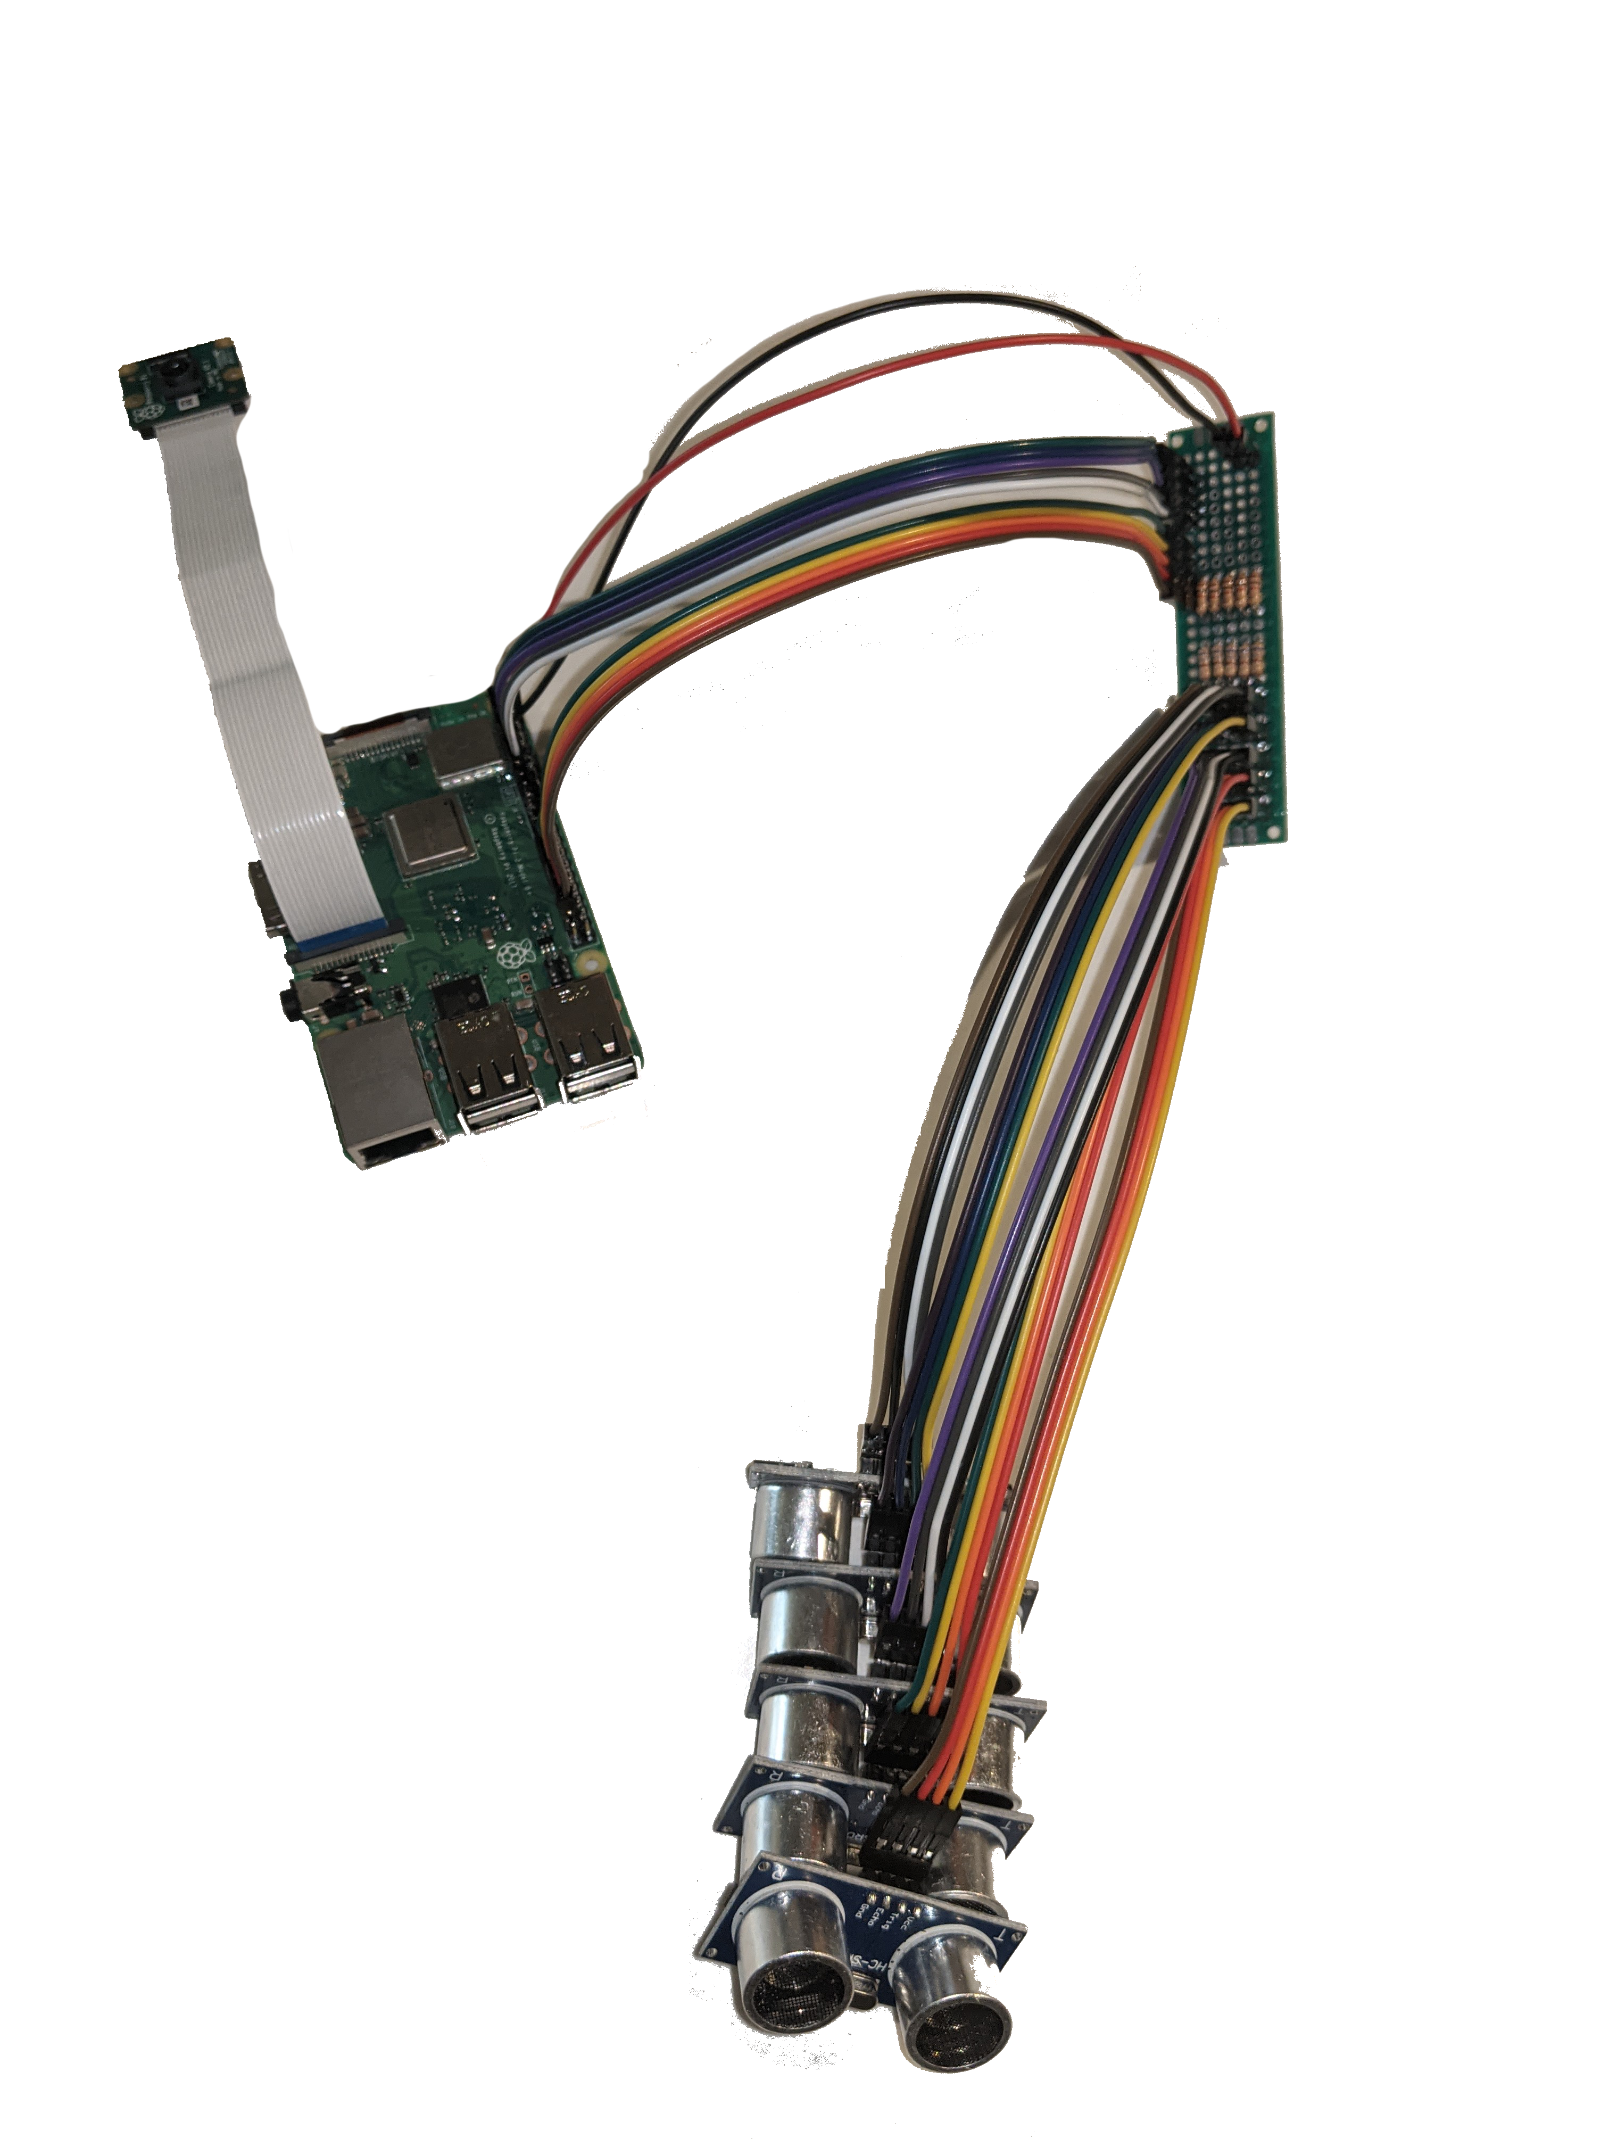
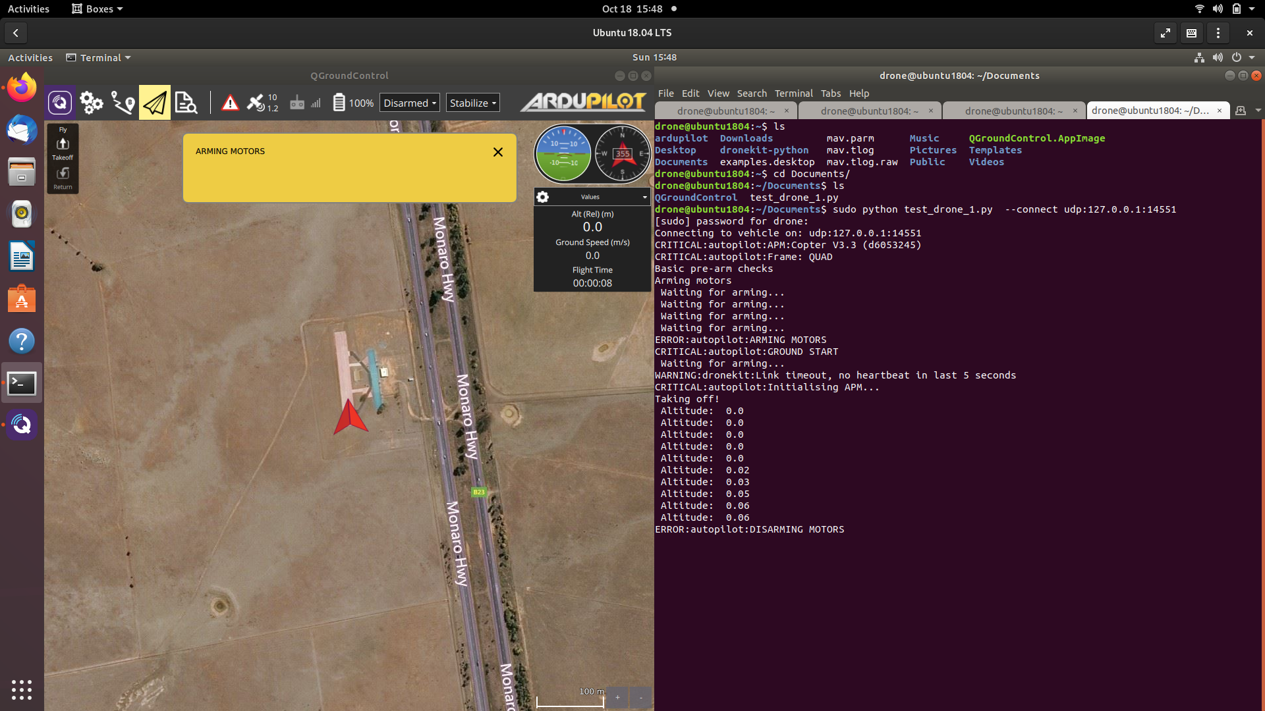
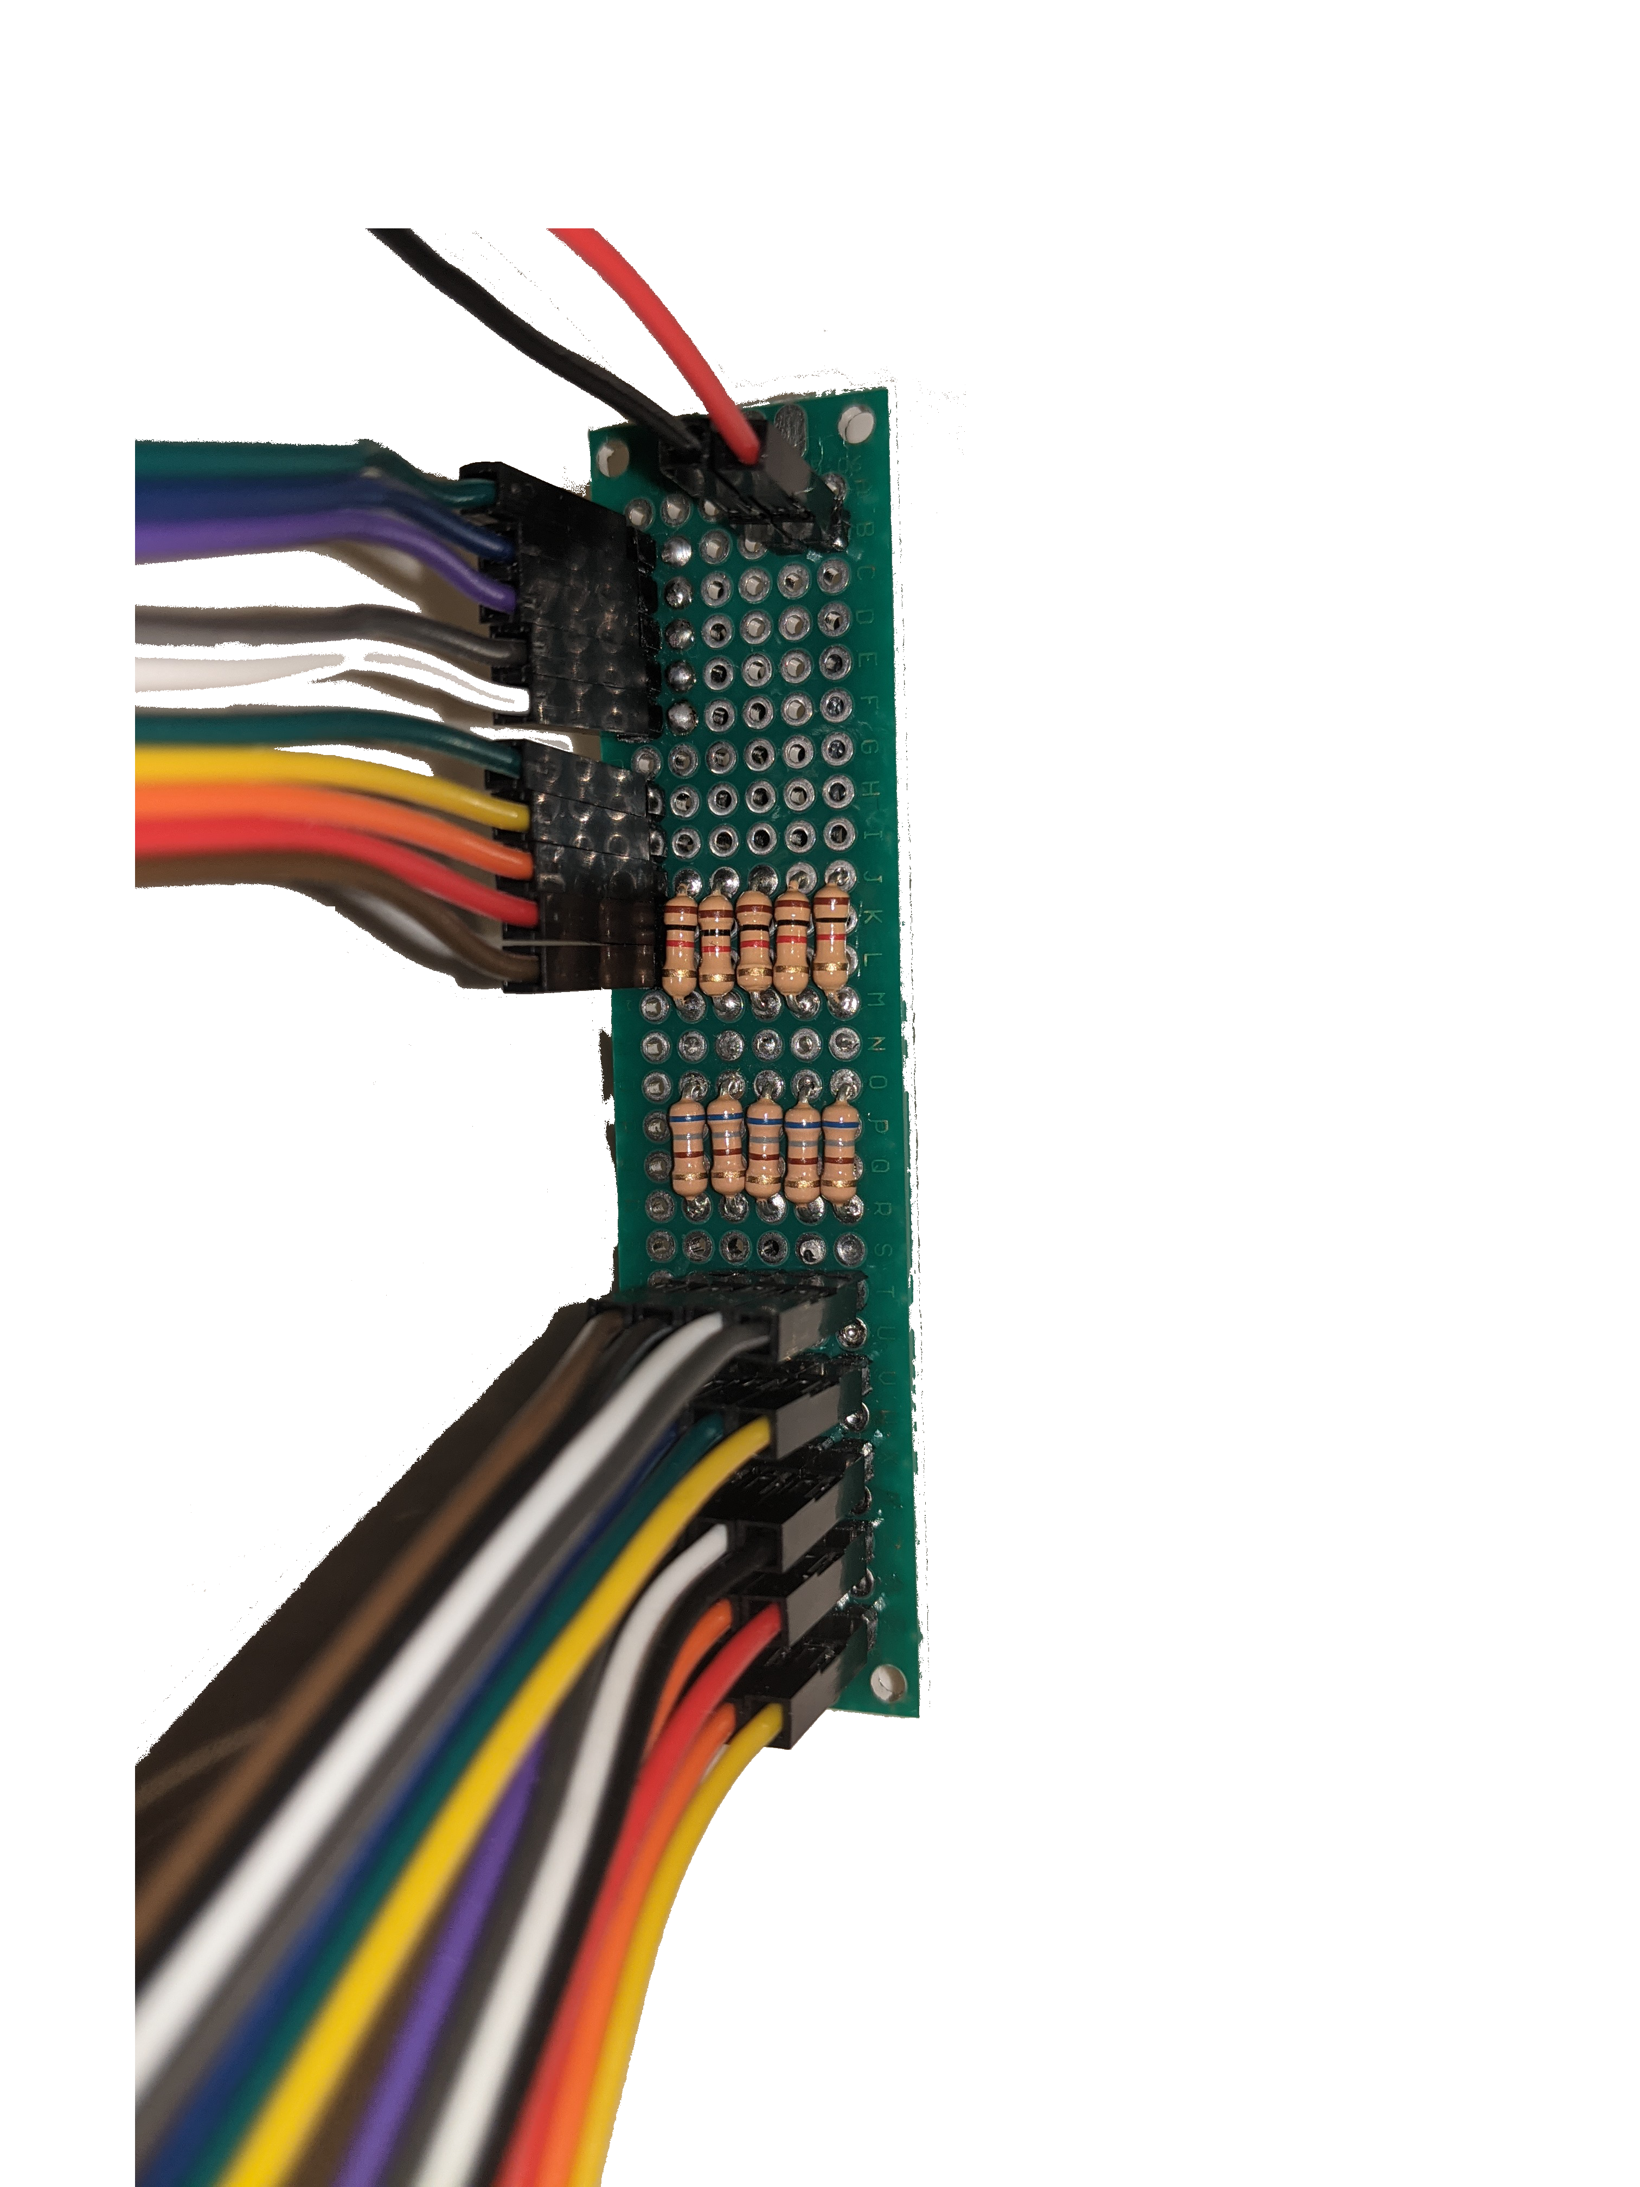
Data Collection & Drone Control
Stages Complete:
Stand alone electronics
Programmed individually and working
Preboard header for sensors working with all sensors.
PiCam records interval video and records to a datasheet with video name and time; working on gathering location data from the drone.
Drone
Drone simulator Running
Program will arm drone and perform safety check
Can monitor drone SITL at time intervals
Stages Remaining:
Fix simulation issues with GPS location
Mount sensors to the drone
Integrate data collection into Waypoint program.

Slide 4
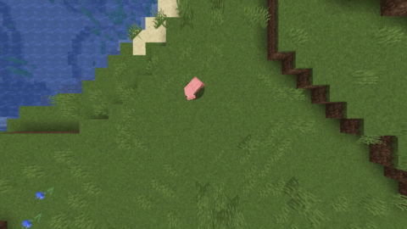
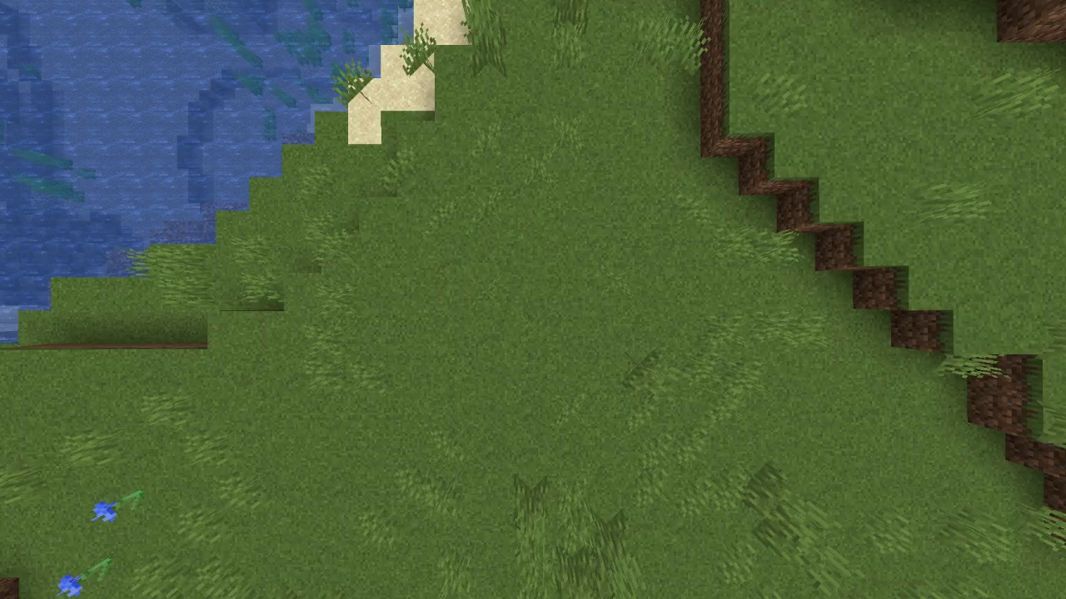
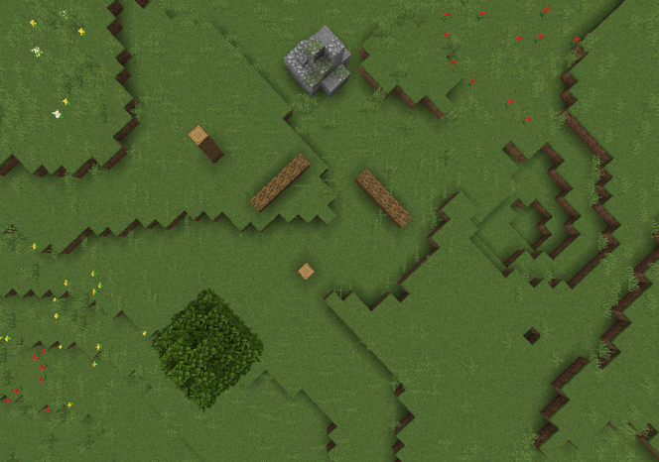

Computer Vision & Mapping
Demo: Moving Object Removal
Stages Complete:
Moving Object Removal
Working as intended.
Image Stitching
Requires more data points than we want to take.
Workaround: Leverage assumptions about the path.
Depth Map Inference
Likely need to tweak parameters depending on data.
Workaround: Provide user an interactive way to do so.
Stages Remaining:
Depth Map Stitching
Most important (and difficult) stage of the pipeline
Gradient Field Derivation
Obstacle Delineation
Input Video
Output Image
Demo: Depth Map Inference
Input Image (Left Eye View)
Output Depth Map

Slide 5
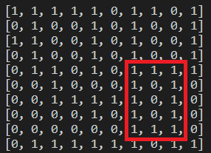
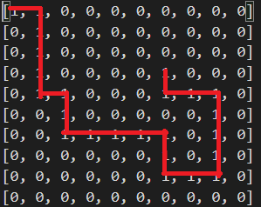
Pathfinding & Drone Detection
Cyclic Path:
Stages Complete:
Finding straightforward path
Working as intended
Paths not taken for final path are marked as invalid (0)
Edge cases and error handling
Edge cases such as finding cycles have been fixed (infinite loops)
Errors such as invalid start/end locations and impossible paths
Stages Remaining:
Program movement of drone
Giving instructions to the drone to follow
Programming drone path from a map input
Bulk of project, formatting the map input for the algorithm
This means creating a new "pixel" of size drone dimension from an area of map pixels
Cyclic Path Solved*:
*The starting location is [0,0] and the ending location is [3,6]

Slide 6
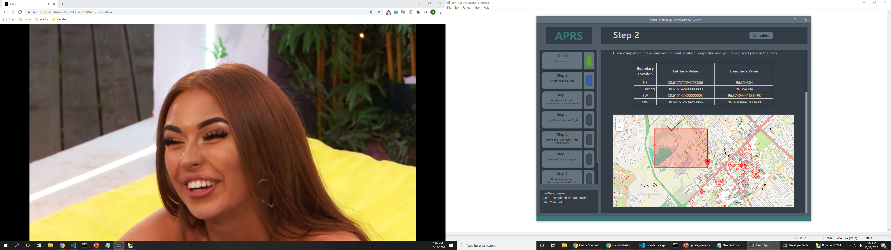
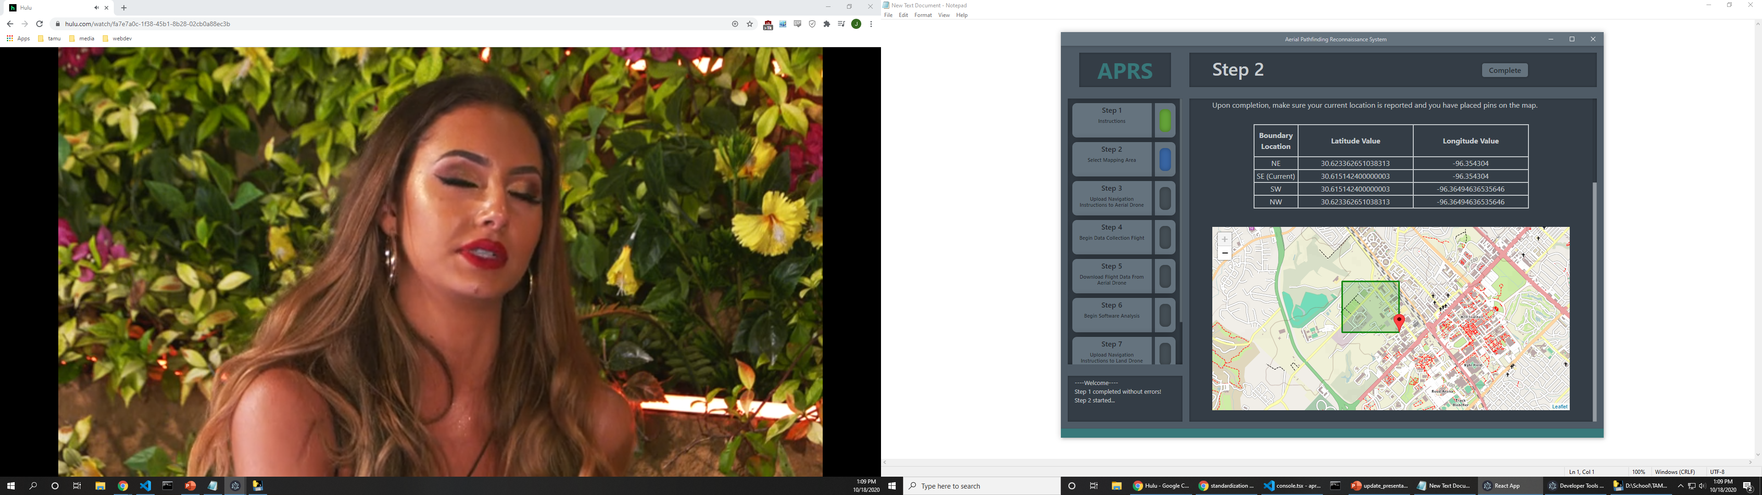
Device Networking & UI
Stages Complete:
Desktop application architecture and UI logic
React Front-end compiled into .exe format
Python Back-end for serving assets and software analysis functions
User input standardization, error handling, and status updates for each stage of the system
Area of operation mapping functionality
User plots area to be mapped by the aerial drone
Creates navigation instructions for aerial drone using Lat-Lng-Elevation waypoints
Stages Remaining:
Implement server architecture on aerial and land drones
Establish communication between desktop app and drones
Mapping functionality: invalid area
Mapping functionality: valid area

Slide 7
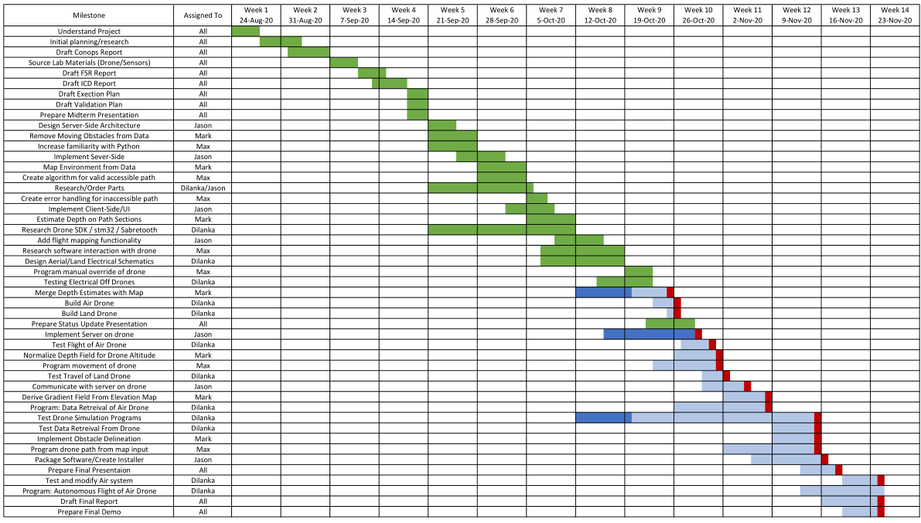
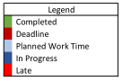
Execution Plan

Slide 8
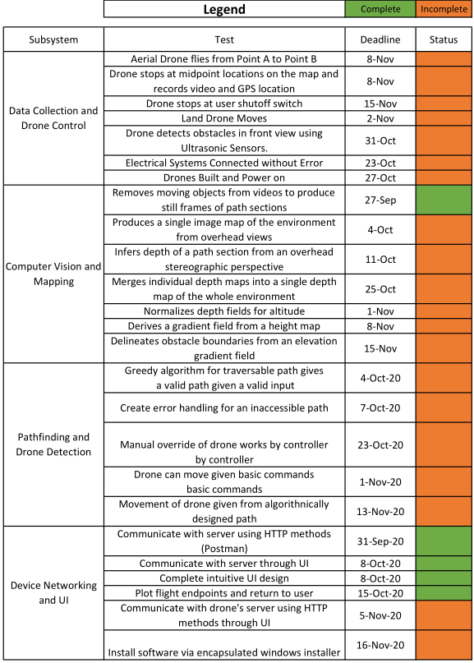
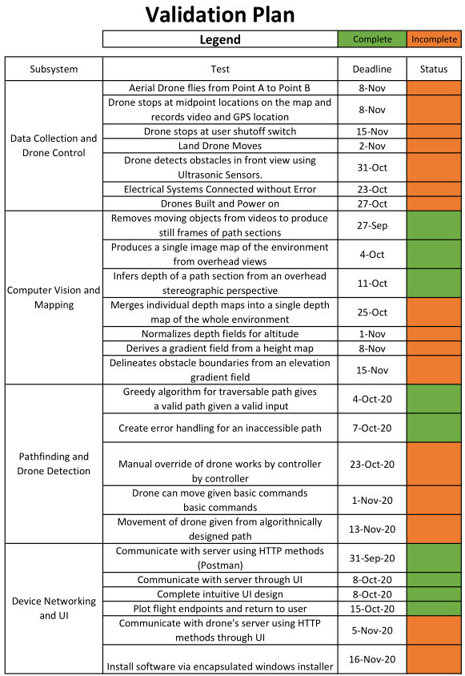
Validation Plan

Slide 9
Key Takeaways
Data Collection & Drone Control
Hardware and software components are working well individually.
Future tasks are largely focused on in-subsystem integration and testing.
Computer Vision & Mapping
Depth inferencing is complete, and about as accurate as we hoped.
Greatest challenge ahead is merging depth maps of path sections.
Pathfinding & Drone Detection
Algorithm and edge cases completed for drone pathing
Next steps are to program drone without a map input and then with a map input.
Device Networking & UI
UI design and functionality completed
Next steps are to establish communication between desktop app and drones.

Slide 10
Questions?

